Slide 1
IOT-PBL
TOPIC : Smart pillow
presented by:
G.SADWIKA (22R11A05F3)
K.HARSHINI (22R11A05F8)
K.SRUJANI (22R11A05G0)

Slide 2
INTRODUCTION:
In today’s fast-paced world, quality sleep is essential for health and well-being. However, snoring is a common problem that affects not only the person snoring but also their partner or roommates. To address this, we present a Smart Anti-Snore Pillow — an innovative Internet of Things (IoT) solution designed to improve sleep by detecting snoring and taking immediate action.
This smart pillow uses an integrated sound sensor to detect snoring sounds in real-time. Once snoring is identified, the system triggers a gentle alert mechanism — such as vibration, inflation, or repositioning — to subtly prompt the sleeper to change their sleeping position without waking them up harshly. This helps reduce snoring and enhances the overall quality of sleep for everyone in the room.
The project combines microcontroller-based hardware, sound analysis, and smart actuation to offer a non-invasive, intelligent solution to one of the most common sleep-related issues. With potential for real-world application in homes, hospitals, and elder care, the Smart Anti-Snore Pillow represents a step forward in smart healthcare and lifestyle enhancement.

Slide 3
METHODOLOGY
The development of the Smart Anti-Snore Pillow involved a systematic approach combining sound detection, signal processing, and mechanical response through embedded hardware. The methodology followed these key steps:
1. Sound Detection
A microphone module or sound sensor (e.g., KY-038 or MAX9814) is embedded in the pillow to continuously monitor ambient sound.
The system is programmed to recognize sound patterns specific to snoring using threshold values or basic signal filtering techniques.
2. Signal Processing
The sound signal is fed to a microcontroller (e.g., Arduino UNO or ESP32).
The microcontroller analyzes the input in real-time to determine if the detected sound matches snoring patterns (e.g., low-frequency, repetitive bursts).

Slide 4
3. Response Mechanism
Upon detection, the microcontroller activates a vibration motor, air pump, or servo motor embedded in the pillow.
This action gently shifts the sleeper’s head position to reduce or stop snoring.
4. Power and Safety
The system runs on a safe DC power supply with low voltage, ensuring user safety.
Components are embedded securely to maintain pillow comfort.
This approach ensures minimal disturbance while actively managing snoring behavior using IoT principles.

Slide 5
HARDWARE REQUIREMENTS
Component | Function
ESP32 | Main microcontroller that processes input from the microphone and controls the servo motor.
Sound Sensor (Microphone module) | Detects snoring sounds and sends signals to the ESP32.
Servo Motors (2x) | Move or reposition the pillow or a flap to adjust the sleeper’s head position gently.
Breadboard | Used for prototyping and connecting components without soldering.
Connecting Wires | Allow data and power transmission between modules and the ESP32.
Power Supply / USB Cable | Powers the ESP32 and connected components.
Cardboard Mechanism + Pillow | Demonstrates the actuation/movement in response to snoring detection.

Slide 6
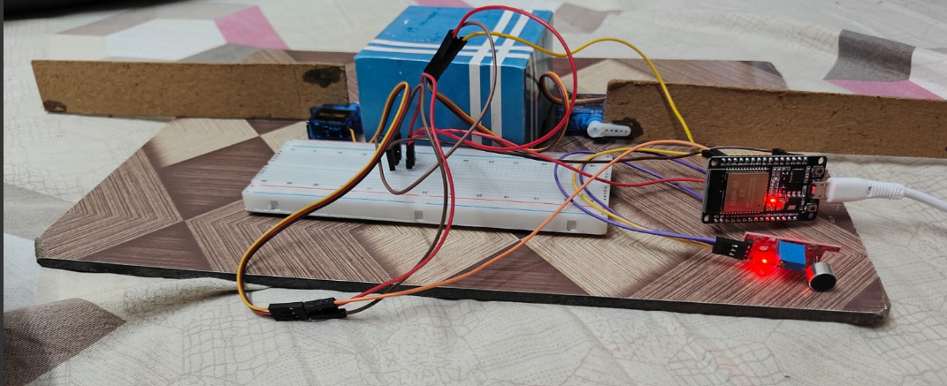
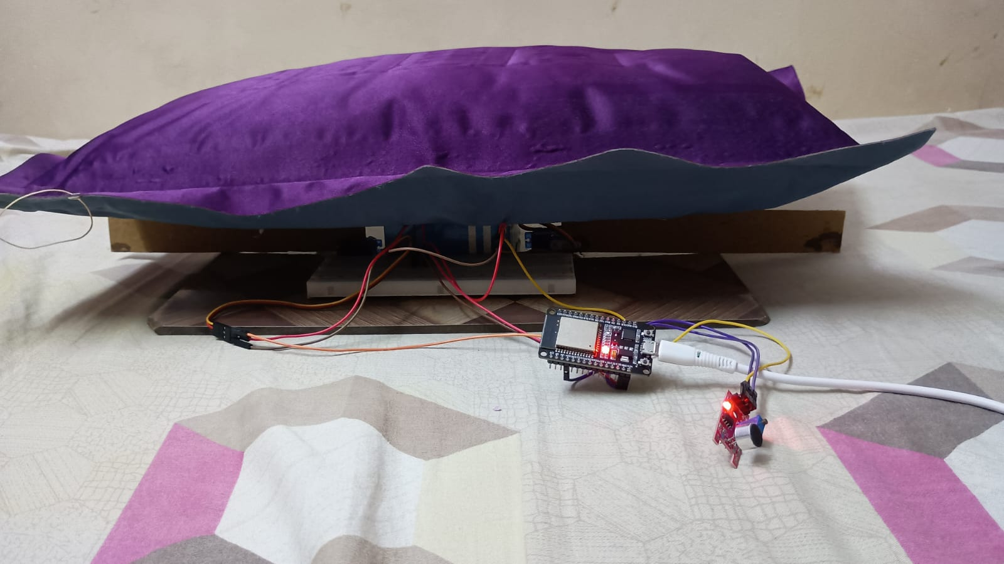
OUTPUT:

